Slide 1
Rational Design of Molecular Catalysts for Selective Ethylene Tetramerization
Weekly Technical Seminar - April 20, 2023
Dr. Sibo Lin
Boston Downstream Research Center

Slide 2
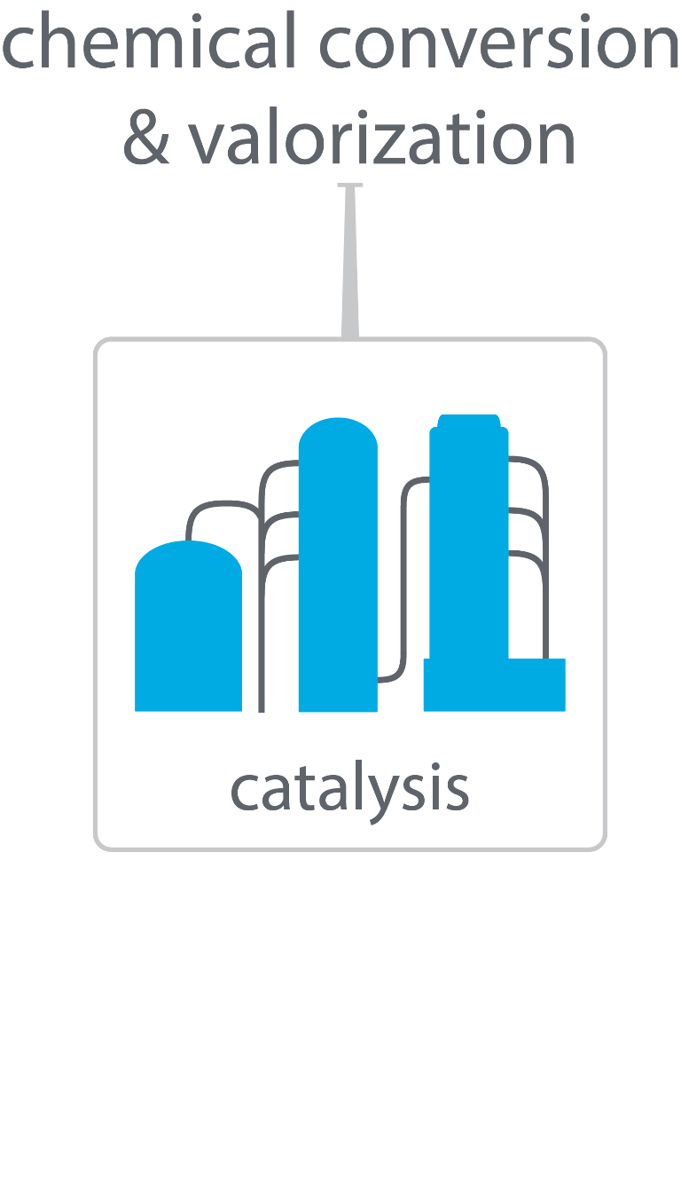
Boston Downstream Research Center
$1.2/kg ¹
$0.83/kg ¹
¹ IHS Markit Report ‘Linear alpha-Olefins, Feb 2020

Slide 3
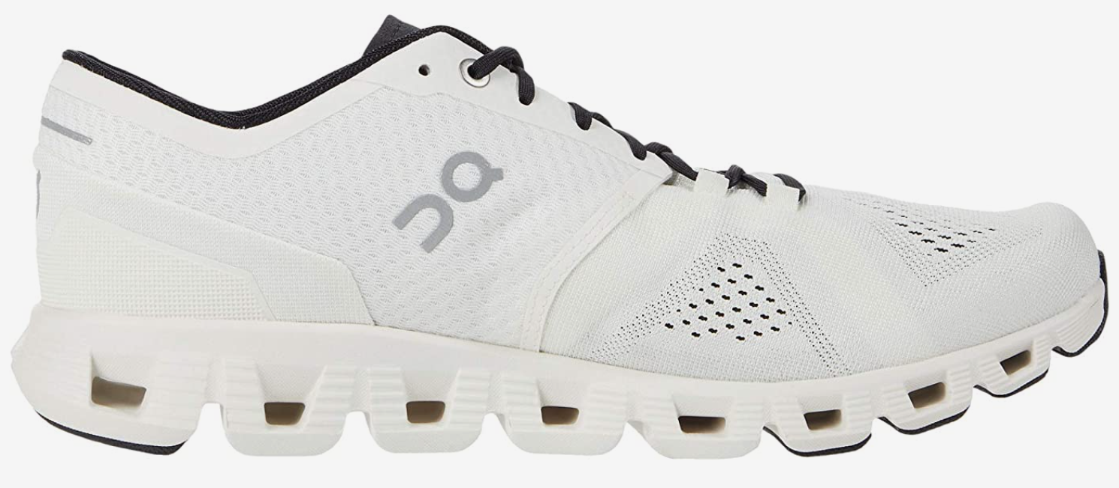
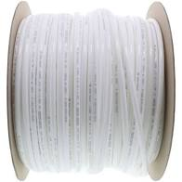

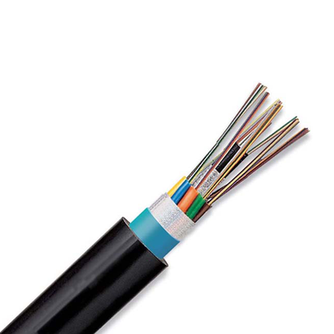
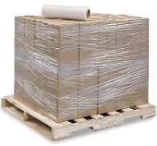
Linear α-olefins for LLDPE
tough
flexible and food-safe
polyethylene plant
LLDPE
1-butene
ethylene
stretchable
electrical and chemical safety
1-butene
1-hexene
1-hexene
1-octene
polymer quality increases
highest quality plastic
1-octene

Slide 4
Intro to Catalysis
Catalysts lower activation energy for reactions
…and can determine product selectivity
~90% of all commercially produced chemical products involve catalysts at some stage
Transportation fuels
Bulk and fine chemicals
Abatement of point-source pollution

Slide 5
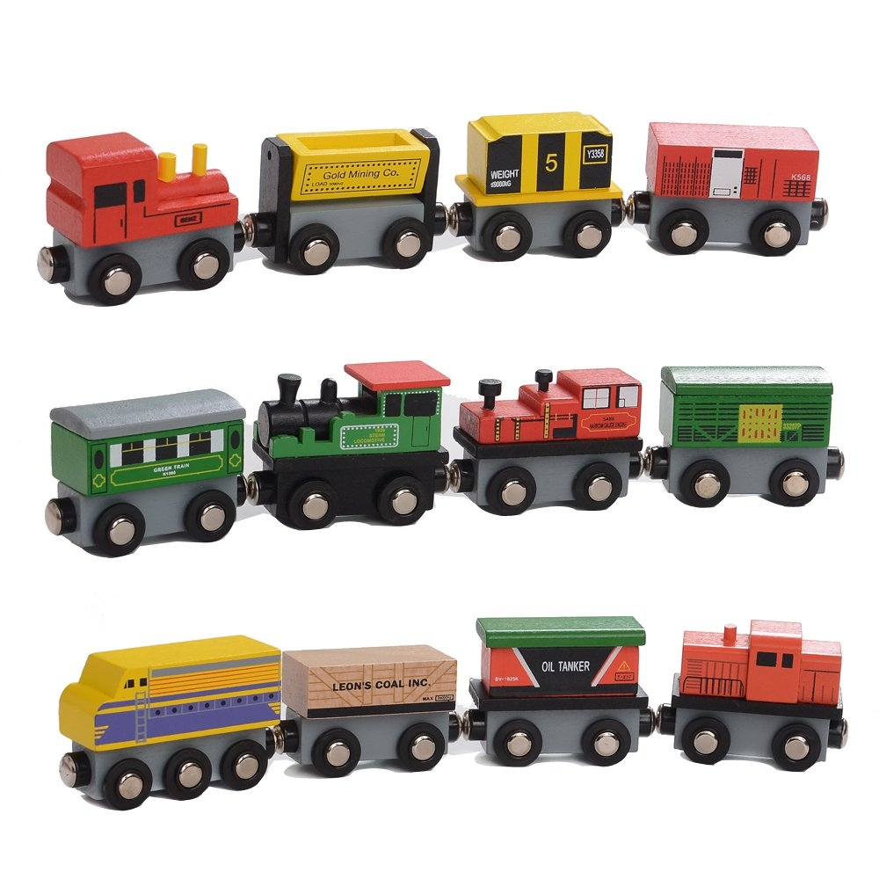
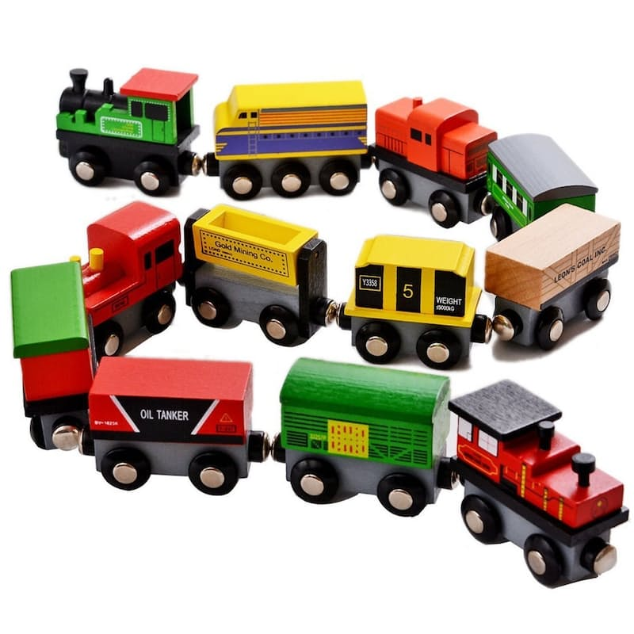

Polymerization vs Selective Tetramerization
catalyst

Slide 6
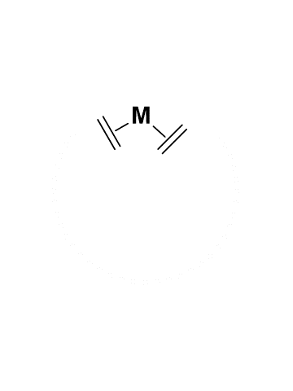
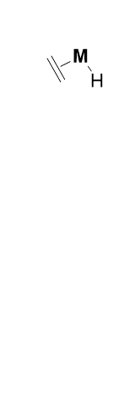
Ethylene Oligomerization Mechanism
Cossee-Arlman Mechanism
(Non-Selective)
Metallacycle Mechanism
(Selective)

Slide 7
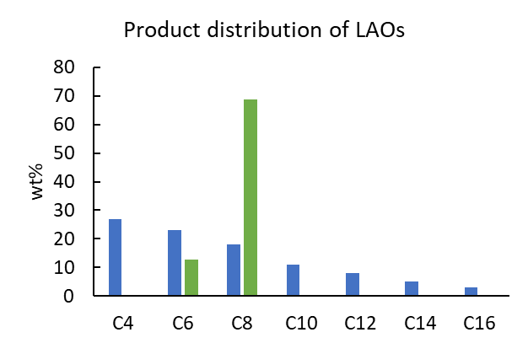
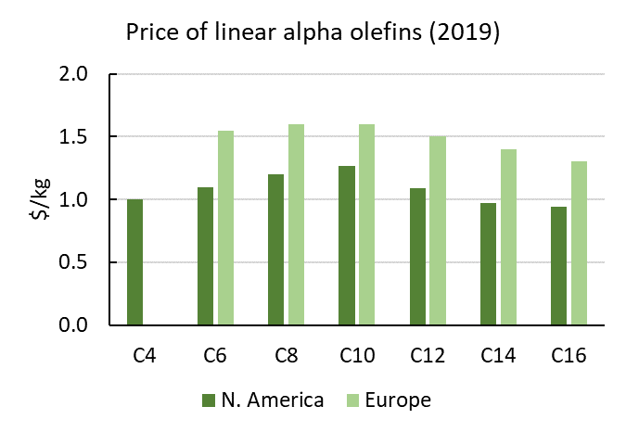
LAO production and prices
Ethylene price in 2019: $0.83/kg
>65 wt% 1-octene
…but reactor fouling
undesired products
<20 wt% 1-octene
IHS Markit Report ‘Linear alpha-Olefins, Feb 2020

Slide 8
Ethylene Tetramerization Challenges
reactor unit fouling
Bollman et al, J. Am. Chem. Soc. 2004, 126, 14712.
Target
Molecular design of novel catalysts that:
Increase activity
Increase 1-octene selectivity
Decrease PE wt%
Notes:
Benchmark References)
Bollman et al, J. Am. Chem. Soc. 2004, 126, 14712 (in toluene and CyH)
Blann et al, J. Catal. 2007, 249, 244. (in MeCy)

Slide 9
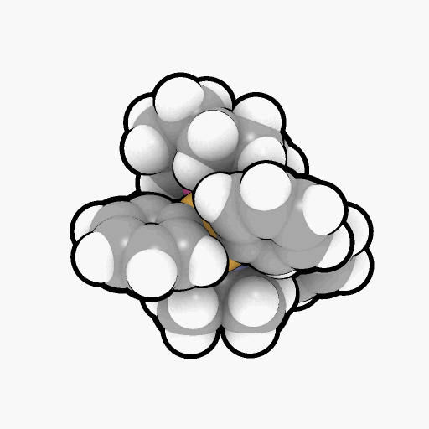
Accelerating Catalyst Discovery with Digital Chemistry
computer-guided workflow
traditional workflow
ligand stability
reaction mechanisms
steric models
aliphatic-soluble ligands
aliphatic-soluble
Cr precursors
Notes:
Use graphics to describe challenges: increase activity, increase 1-octene selectivity, decrease PE selectivity

Slide 10
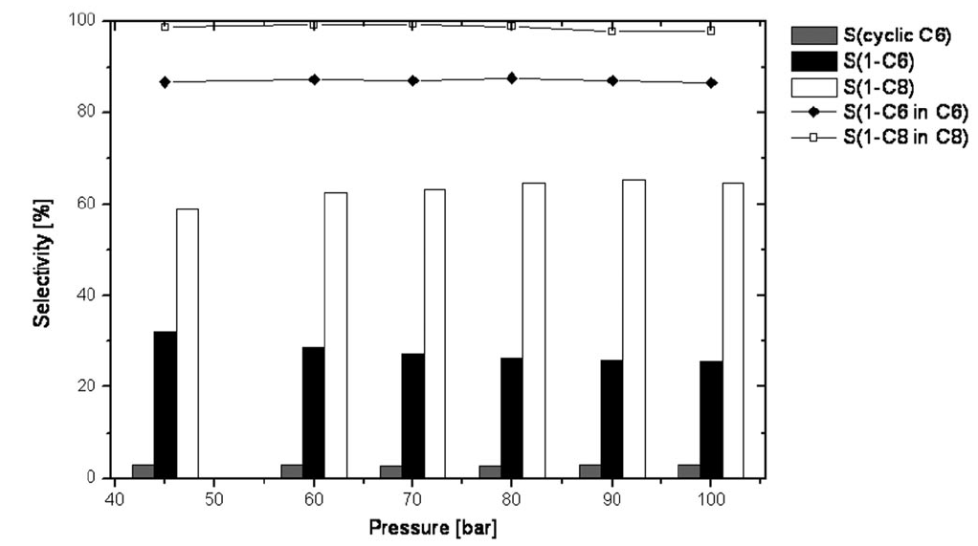
Accepted Mechanism Tested By Pressure Insensitivity
Proposed rate equations:
1-octene formation rate = k₁ [Cr] [ethylene]⁴
1-hexene formation rate = k₂ [Cr] [ethylene]³
Increasing [ethylene] should increase 1-octene selectivity…
ΔΔG
How to find transition state geometries?
Kuhlmann, S. et al Adv. Synth. Catal. 2006, 348, 1200

Slide 11
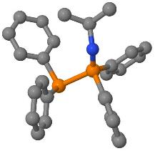
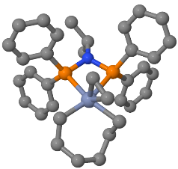
Mechanism: Automated Conformer Analysis
autoConf
Automated multi-level conformational search
Built on 3 open-source engines:
GFN-xTB/CREST
NWChem
GoodVibes
Simplified user input
Lightweight (for facile installation on internet-restricted compute clusters)
input geometry
(and charge and spin)
final structure and energy
XTBDFT
single-ended reaction coordinate scan
(GFN-xTB)
conformer ensemble generation & ranking
(CREST and GFN-xTB)
ensemble refinement (NWChem)
minimum final optimization (NWChem)
quasi-harmonic frequency corrections
(Goodvibes)
input reactant geometry
specify reaction coordinate
(and charge and spin)
final TS structure and energy
How many conformers within 6 kcal/mol window?
autoTS
Lin, S.; Fromer, J. C.; Ghosh, Y.; Hanna, B.; Elanany, M.; Xu, W. Sci. Rep. 2021, 11, 4534
Lin, S.; Elanany, M.; Khawaji, M. SoftwareX 2022, 20, 101242

Slide 12
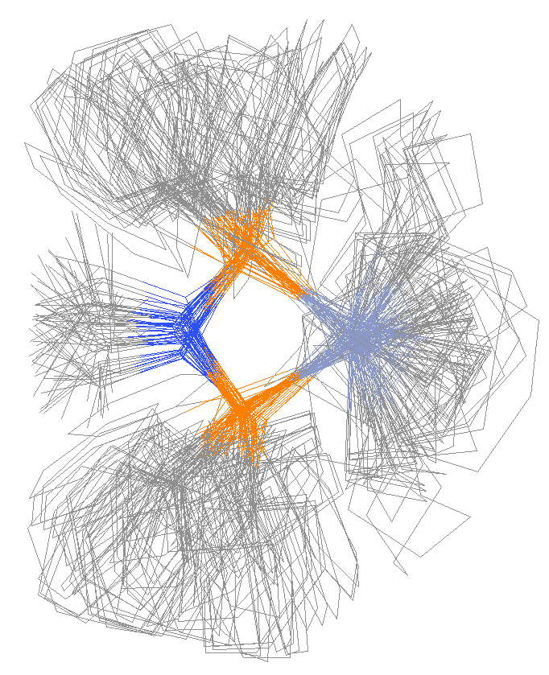
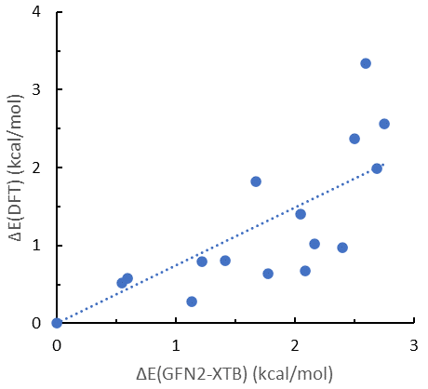
XTBDFT Case Study: Ethylene Insertion Transition State
a
b
c
reaction coordinate scan
GFN2-XTB can help screen the lowest energy conformers
reaction path finder
constrained conformer search
69 conformers within 6 kcal/mol window
XTBDFT facilitates modelling of complicated molecules
Lin, S.; Fromer, J. C.; Ghosh, Y.; Hanna, B.; Elanany, M.; Xu, W. Sci. Rep. 2021, 11, 4534
Lin, S.; Elanany, M.; Khawaji, M. SoftwareX 2022, 20, 101242

Slide 13
Mechanism: Rate-Limiting Steps
toward
1-hexene product
toward
C₁₀₊ products
toward
1-octene product
turnover-limiting barriers
Computational details: NWChem 6.8, M06-D3/def2-TZVP//B3LYP-D3/def2-SVP + solvation energy (M06-D3/def2-SVP)

Slide 14
Mechanism: 1-C₈ vs 1-C₆ Determining Steps
toward
1-hexene product
toward
C₁₀₊ products
ethylene ligand assists BHT
toward
1-octene product
T
Ethylene-assisted BHT explains why increased ethylene pressure does not yield higher 1-C₈ wt%
turnover-limiting barriers
product-determining barrier
ΔΔG(1-hexene/1-octene) = 3.1 – 0.6 = 2.5
Computational details: NWChem 6.8, M06-D3/def2-TZVP//B3LYP-D3/def2-SVP + solvation energy (M06-D3/def2-SVP)

Slide 15
Mechanism: PhCl facilitates 1-hexene release
Avoid use of chlorinated (co)solvents
Cl coordination lowers 1-octene/1-hexene
Corrosivity requires more expensive alloys for high pressure reactors
Stick to aliphatic solvents
Computational details: NWChem 6.8, M06-D3/def2-TZVP//B3LYP-D3/def2-SVP + solvation energy (M06-D3/def2-SVP)

Slide 16
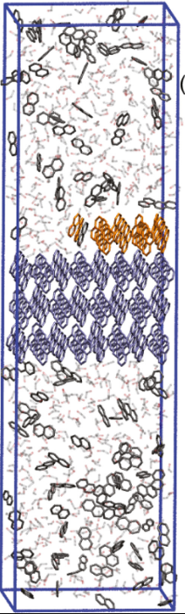
Designing Greater Aliphatic Solubility
“solubility” means [ Solvent-Solute Interactions ] >> [ Solute-Solute Interactions ]
Low [ Solute-Solute Interactions ] manifests as low melting temperature
insoluble in hexanes
To enhance aliphatic solubility, design ligand with cis-1,4-substituted cyclohexyl substitutent
soluble in hexanes
Bjelobrk et al. Cryst. Growth Des. 2021, 21, 5198

Slide 17
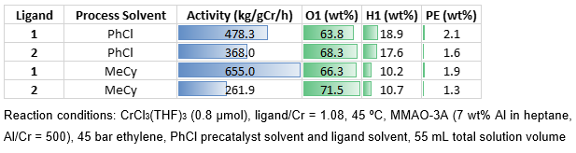
Initial Experiments with CrCl₃(THF)₃ and PhX co-solvent
~2x activity of benchmark ligand 2
Patent filed on novel ligand 1 (SA6977)

Slide 18
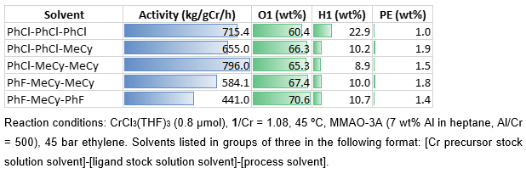
Initial Experiments with CrCl₃(THF)₃ and PhX co-solvent
lower [PhCl] does yield higher 1-octene

Slide 19
Switching to More Soluble Cr Precursor
soluble | DCM, THF, PhCl | DCM, THF, PhCl, aromatics | DCM, THF, PhCl, aromatics, aliphatics
insoluble | aromatics, aliphatics | aliphatics | --

Slide 20

Screening Related Catalysts
* Ligand 1 was sent to ARC@KAUST during their summer vacation and spent a few weeks outside of a glovebox
Conditions: Cr(TMHD)₃ = 1 μmol, L/Cr = 1, MMAO-3A = 2 mmol (Al/Cr 2000), Heptane, Total solution volume = 100 mL, 45 bar, 45 ºC, 10 min.
Heptane inhibits polyethylene formation

Slide 21

Summary of Ethylene Tetramerization
1-C₈ cannot be induced with higher [ethylene] or PhCl solvent
Design of novel ligands for aliphatic solubility
Future Directions
Two manuscripts are being written by BDRC
Collaborators at SARC@KAUST and KFUPM are refining the catalyst with anti-fouling additives, varying process parameters, and larger scale (600 – 2000 mL)
A final formulation will be handed off to SABIC in a Gate 4 meeting in Q3
Increase activity
Increase 1-octene selectivity
Decrease PE wt%

Slide 22
Acknowledgements
Aramco Americas
Advanced Materials Team (Cambridge, MA)
Saudi Aramco Chemicals R&D at KAUST
Mohamed Elanany
Motaz Khawaji
Wei Xu
Jenna C. Fromer
Yagnaseni Ghosh
Brian Hanna
Douglas Theberge
Dana A. Wong
Atieh Abu Raqabah
King Fahd Univ. of Petroleum and Minerals
E. A. Jaseer
Samir Barman
Nestor Garcia

Slide 24
Ethylene Oligomerization Mechanisms
Typically yields Schulz-Flory distribution of oligomers
May yield 1-hexene, 1-octene, or Schulz-Flory

Slide 25
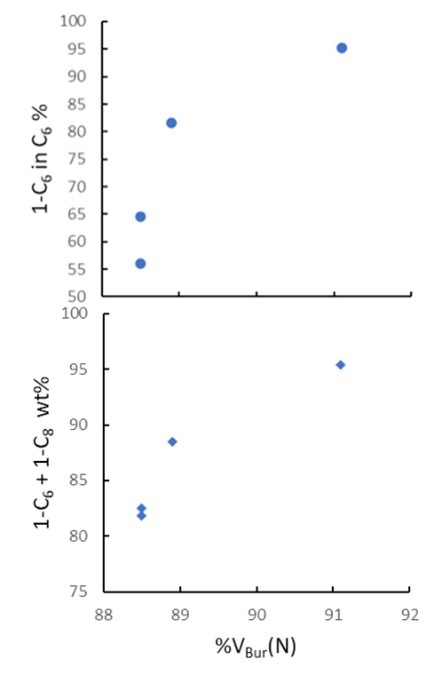
Ligand Bulk Correlates with Total LAO (1-C₆ + 1-C₈) wt%
Buried Volume @ Nitrogen: %V_{Bur}(N)
Calculated with SambVca
(Prof. Cavallo, KAUST)
Calculable for all PNP ligands
%V_{Bur}(N)
A
88.9
D
A
B
88.5
B
C
C
88.5
D
A
C
B
D
91.1
Barman, S.; Jaseer, E. A.; Garcia, N.; Elanany, M.; Khawaji, M.; Xu, W.; Lin, S.; Alasiri, H.; Akhtar, M. N.; Theravalappil, R. Chem. Commun. 2022, 58, 10044
Patent US11484871B1, Nov. 1, 2022.

Slide 26
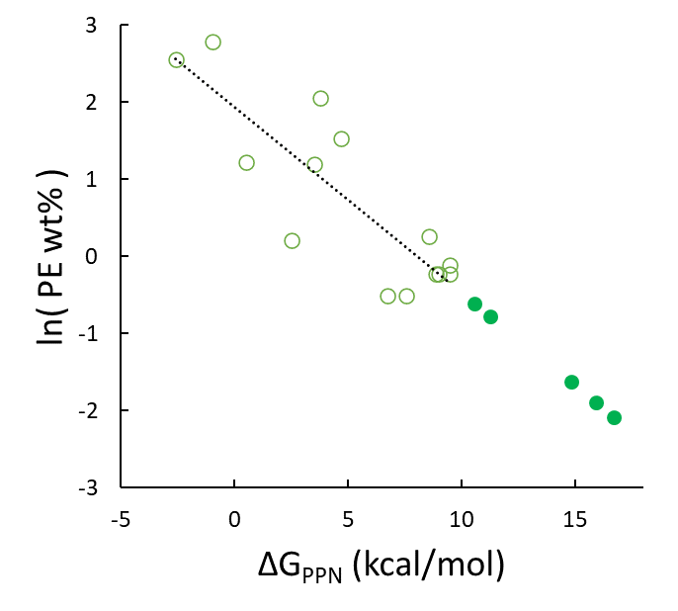
Ligand Stability Correlates with Lower PE wt%
Will extra-stable ligands yield very low polyethylene?
projected
activities
Lin, S.; Fromer, J. C.; Ghosh, Y.; Hanna, B.; Elanany, M.; Xu, W. Sci. Rep. 2021, 11, 4534.

Slide 27
Mechanism: Prior DFT Study
Observations
Simpler ligand used (N-Me instead of N-iPr)
Only explored a few conformers:
7 for ethylene adduct (18b)
3 for ethylene insertion TS (TS18f-19)
1 for beta hydride trainsfer TS (TS8-12)
Predicted too high 1-C₈/1-C₆ ratio (ΔΔG = 5.7 kcal/mol)
Empirically, 1-C₈/1-C₆ does not exceed ~6, even at high pressures—why?
Strategy
Analyze the full ligand (N-iPr)
More exhaustively search molecular conformations
Britovsek, G. J. P.; McGuinness, D. S. Chem. Eur. J. 2016, 22, 16891

Slide 28
XTBDFT Case Study: Ethylene Insertion Transition State
nohup xtbdft.py start.xyz -chrg 1 -uhf 3 -mode autoTS 28 65 1.6 -other=”-cbonds 1.0” &
“nohup” and “&” to run job in background
“-chrg” and “–uhf” to denote charge and unpaired electrons
“-mode” set to autoTS
Reaction coordinate:
Distance between atoms 28 & 65, from 3.06 to 1.60 Å
constrains all bonds with harmonic potential to prevent Cr-P dissociation
(1.0 Hartree/Bohr² force constant)
Lin, S.; Fromer, J. C.; Ghosh, Y.; Hanna, B.; Elanany, M.; Xu, W. Sci. Rep. 2021, 11, 4534
Lin, S.; Elanany, M.; Khawaji, M. SoftwareX 2022, 20, 101242
Code and Tutorials at: https://github.com/sibo/xtbdft

Slide 29
linear α-olefins for LLDPE
1-octene production
tough
flexible and food-safe
1-butene
>65 wt% 1-octene
…but reactor fouling
stretchable
electrical and chemical safety
1-hexene
undesired products
1-octene
<20 wt% 1-octene

Slide 30
1-Octene Price
Ethylene price in 2019: $0.83/kg
IHS Markit Report ‘Linear alpha-Olefins, Feb 2020

Slide 31
Computational: Calculating PNP stability against PPN isomerization
2
2
3
2
3
2
3
how many conformers?
ca. 3³ x 2⁴ = 432
too many to rely on human intuition or employ brute-force high-level simulations
wrong ΔG
right ΔG

Slide 32
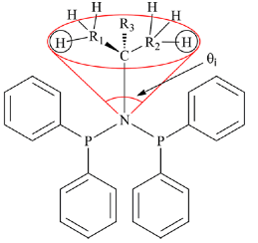
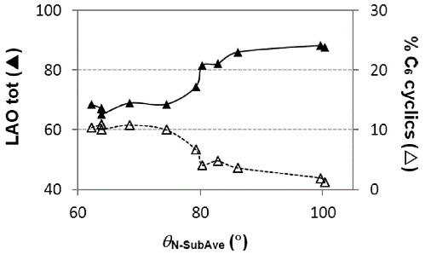
“Buried Volume” to Evaluate Ligand Sterics
Effective Tolman-based Cone Angle: θ_{N-Sub}
Sasol found correlation with LAO total (1-C₆ + 1-C₈)
Only useful for narrow range of PNP ligands
Buried Volume Around Nitrogen: %V_{Bur}(N)
Calculated with SambVca (Prof. Cavallo, KAUST)
Calculable for all PNP ligands
Correlates with some catalyst outputs
Cloete and coworkers, Inorg. Chem. 2013, 52, 2268-2270
%V_{Bur}(N) = 88.9

Slide 33

“Buried Volume” to Evaluate Ligand Sterics
Buried Volume Around Nitrogen: %V_{Bur}(N)
Calculated with SambVca (Prof. Cavallo, KAUST)
Calculable for all PNP ligands
Correlates with some catalyst outputs
%V_{Bur}(N) = 88.9
Buried Volume → higher productivity and lower PE wt%
Notes:
Geometries optimized by Mohamed with DMol3 as cationic, quartet spin chromacycloheptane species
Buried volumes calculated by Sibo with SambVca
Experimental data from 2 Sasol papers:
Kuhlmann et al, J. Catal. 2007, 245, 279-284
Blann et al, Chem Commun 2005, 620-621
These trends are much weaker with KFUPM’s experimental data in PhCl, other mechanisms/trends may be operative in different solvents.

Slide 34
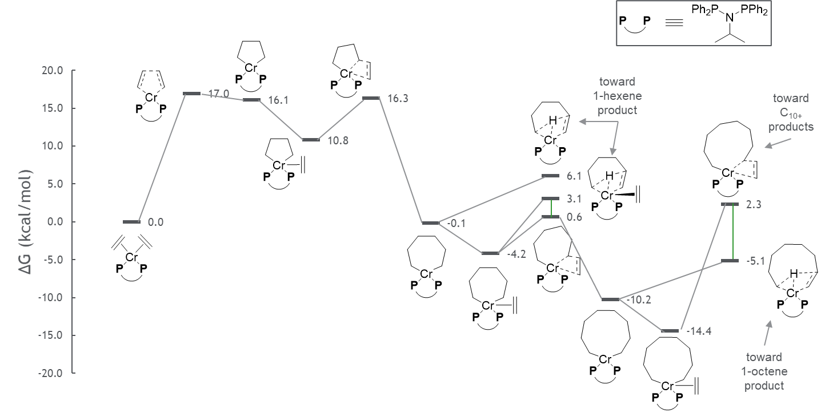
Computational: First Detailed Reaction Mechanism of Full Sasol Ligand
correct prediction of 1-octene/1-hexene ratio
turnover-limiting barriers
product-determining barriers
Ongoing: PhX solvents may act as secondary ligands to alter product distribution
Lin, S.; Elanany, M.; Khawaji, M.; Xu, W. ACS Catal. 2021, in preparation

Slide 35
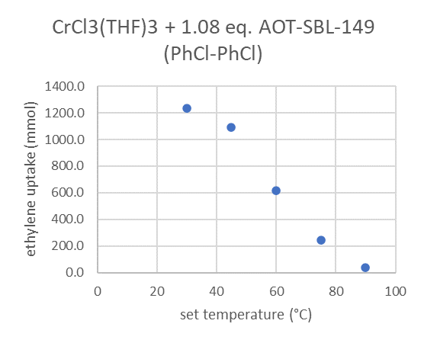
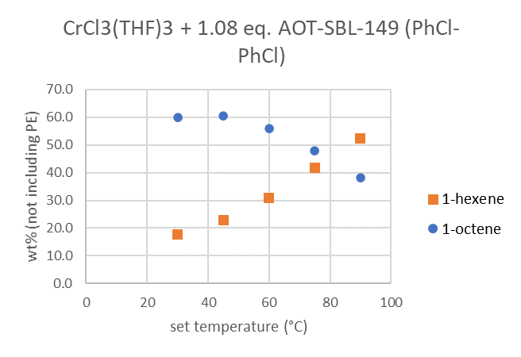
Reaction Temperature Optimization of AOT-SL-149
Reaction conditions
0.8 μmol CrCl₃(THF)₃
1.08 equiv. AOT-SL-149
500 equiv. Al (MMAO-3A)
45 bar ethylene
PhCl solvent
60 min
Lower temperature increases activity and 1-octene selectivity
35

